Slide 1
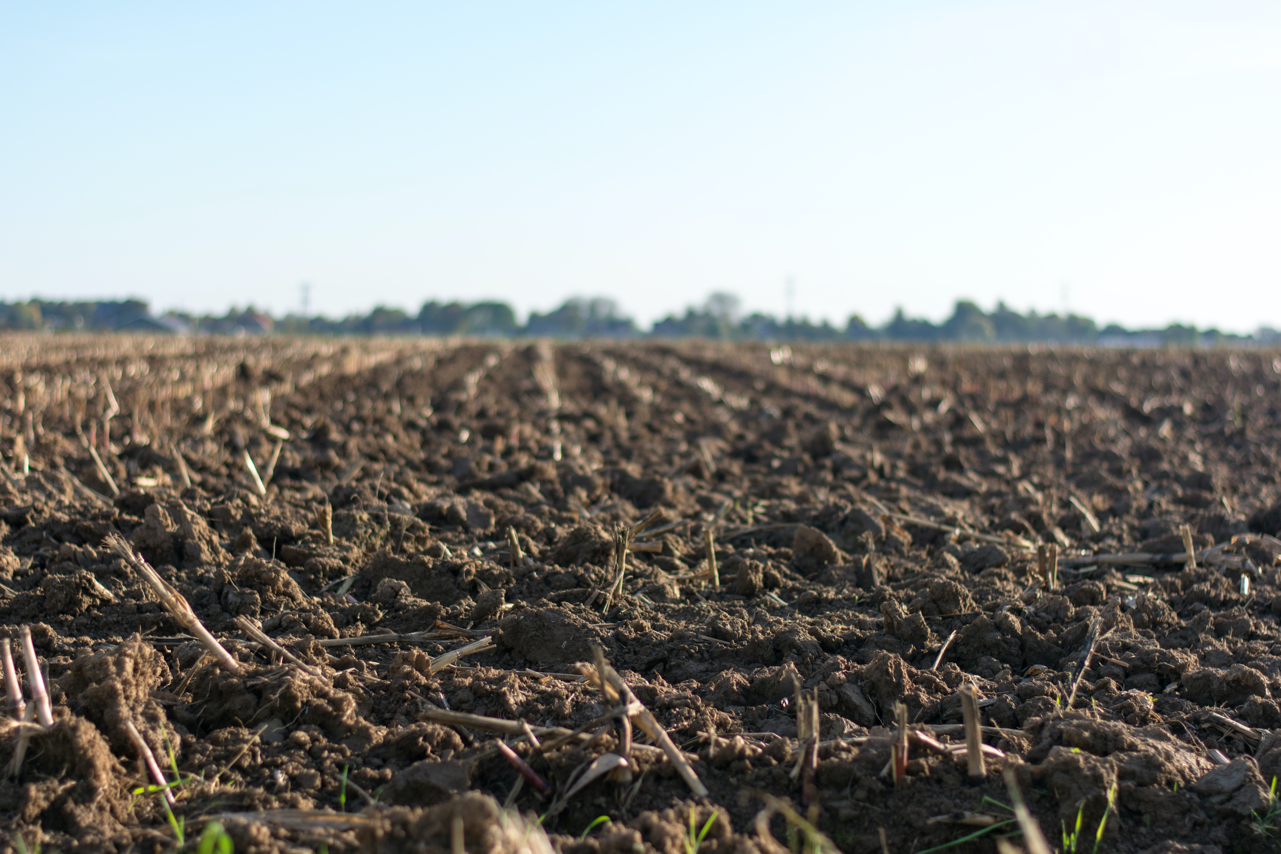

THE MOST ECONOMICAL WAY TO TURN MANURE INTO COMPOST
tim@dungstercomposting.com
www.dungstercomposting.com

Slide 2


Part 1,
Manure Composting
Economics
(presented April 13th 4PM at 2023 at Equine Affaire)
dungstercomposting.com

Slide 3
Part 1 of a 2 part Presentation
dungstercomposting.com

Slide 4
Part 2,
Composting Manure,
Hygiene, Health & Ecology
(presented April 14th at 1PM, Equine Affaire)
dungstercomposting.com

Slide 5
Bio of Tim Shuttleworth
Retired (twice) from global, 4-decade long manufacturing career, 18 years as the CEO.
Grew-up on an Indiana chicken farm, youngest of 8 kids
Father grew tomatoes and ran a tomato cannery (1911 - 1961)
Later, his step-father was a horse trainer (sulky trotters and pacers)
Earned a Certificate in Environmental Studies (1981)
Earned a MBA from University of Notre Dame with Honors (1988)
Compulsive recycler and inventor (6 patents)
Married 41 years, 5 married kids, 9 grandkids (and counting…)
dungstercomposting.com

Slide 6
Composting Economics
In short, the cost (capital and operating) and effort to compost manure is more than recovered by the produced and Valued Agricultural Product; COMPOST.
And the avoidance of unnecessary expenses such as DISPOSAL FEE$.
Bonus Material: Economy of Effort
dungstercomposting.com

Slide 7

Valued Agricultural Product ?
YES!
dungstercomposting.com

Slide 8
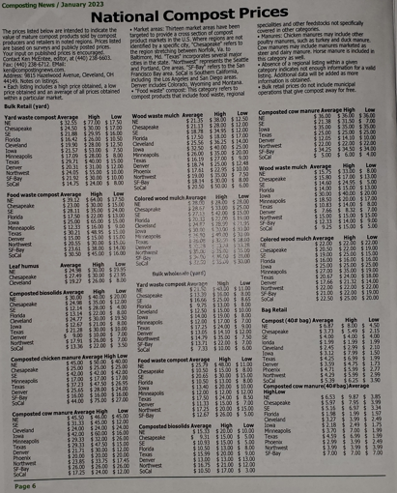
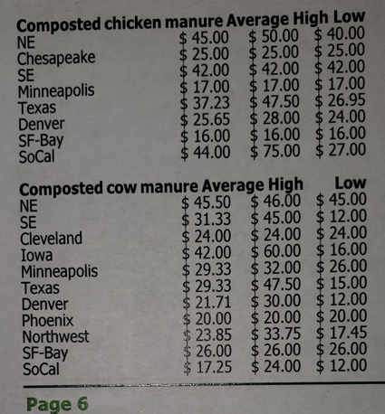
National Compost Prices
Average $31/Yard
Average $28/Yard
dungstercomposting.com

Slide 9
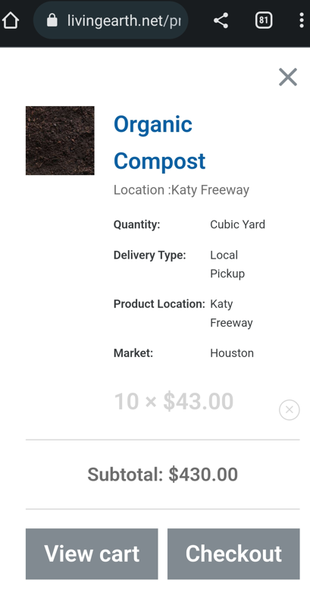
A Valued Ag Product? Yes!
“Organic Compost” from
Living Earth, Houston TX
Price range of $30.00 to $60.00/cubic yard … in bulk sales.
Example “Living Earth” sells compost $43.00/yard (in January).
“Living Earth” is a Texan manure disposal contractor.
They “buy” their inputs for “zero $” or with a “negative” price.
They convert these inputs into “Organic Compost”.
10 x $43.00
dungstercomposting.com

Slide 10
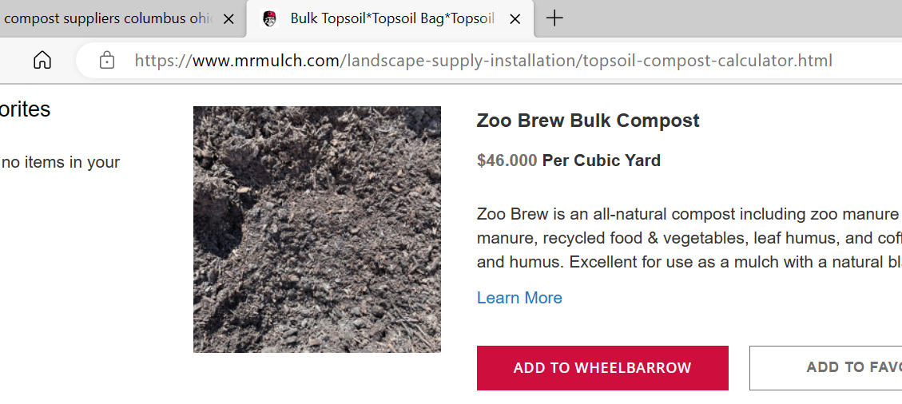
Another Example; Columbus Supplier “Mr. Mulch”, website price as of April 13th 2023

Slide 11
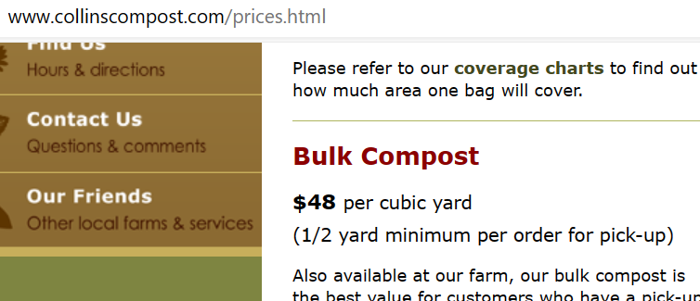
Local Compost sales
dungstercomposting.com

Slide 12
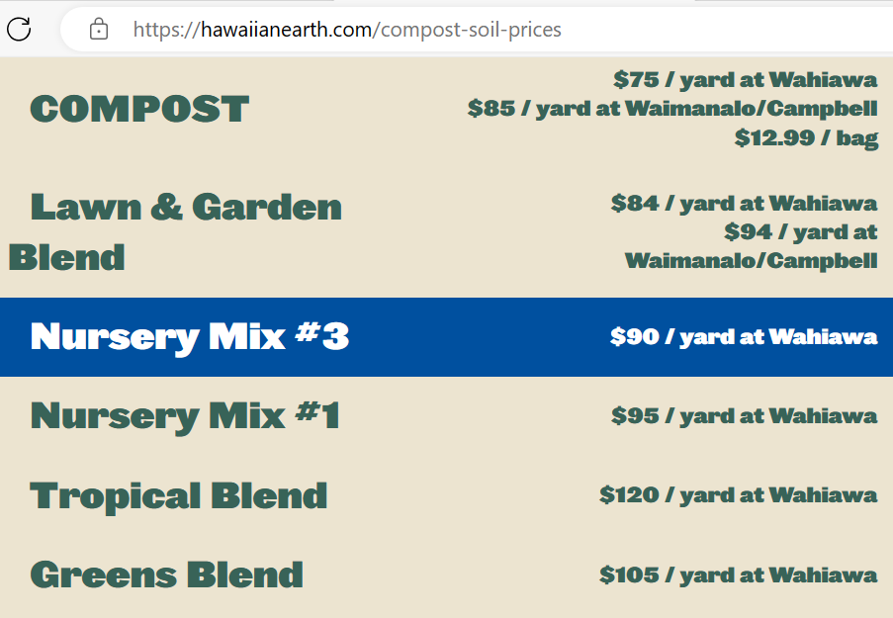
Source
Summarize Compost Prices:
Compost News $30.00/Yd
Living Earth $40.00/Yd
Mr. Mulch $46.00/Yard
Collins Compost $48/Yd
Hawaiiearth:
Lowest:$75.00/Yd
Highest: $120.00/Yd
Low of $30.00/Yard
High of $120.00/Yard
dungstercomposting.com

Slide 13
Minimize Costs and Maximize Revenues
Composting Manure Business Rationale
On the Income Statement …
and the Balance Sheet …
Convert a liability (manure) into an asset (compost)
dungstercomposting.com

Slide 14
Where do most of your purchases finally rest?
…in the manure pile!
dungstercomposting.com

Slide 15
If you own manure, you own a “diamond in the rough”…
…$ell your Compost for a profit!
Or gift the finished compost to your clients and/or your neighbors
dungstercomposting.com

Slide 16
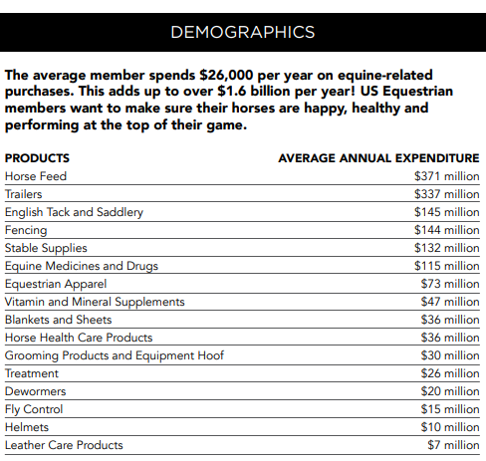
Big Picture on Horse Costs
Source: US Equestrian Foundation website
#1 Expense, Feed
#5 Expense, Stable Supplies (bedding)
Where do these purchases end up???
In your manure pile!
Bonus Benefits of Composting (Part2)
Fly mitigation for free
Worm mitigation for free
Are you paying manure disposal fees?
Cost avoidance is cash in the bank
dungstercomposting.com

Slide 17
Professional
Boarders
Can property aesthetics improve your bottom-line?
Do you have “drive-by” potentials that do not come in?
What was a potential client’s first impression … a foul odor or a fly problem?
Are there potential clients who are environmentalists?
On-site composting makes a positive Statement!
dungstercomposting.com

Slide 18
A Composting Manure Management Plan
Manure is never laying on the ground.
Manure is:
containerized, covered preparing to be composted or is
actively composting or
is already Composted Manure (it is done).
On-site Composting is a POSITIVE statement.
dungstercomposting.com

Slide 19
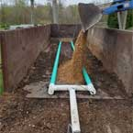
A Composting Cycle, Step-by-step
#0 Get set-up with a dumpster (one time)
#1 Load aeration pipes (15 minutes, no tools)
#2 Layer of coarse wood chips (15 minutes)
#3 Load manure & soiled bedding
If stock-piled, with a tractor (1 hour)
If from daily chores, depends
#4 Turn on the control and watch the temps
#5 For 3 to 5 weeks check temps once a day
Dungster turns the knobs, …not the piles
#6 When temps decline its time to unload
(unload could be minutes to a couple hours)
#7 Return to step 1 above
Operating costs,
next slide…
Set aside to cure 30-60 days
dungstercomposting.com

Slide 20
Dungster’s Monthly Power Cost
Blower, 6 amps x 120 volts = 720 Watts or 0.72 kW
Run Cycle, 20 seconds “on” / 20 minutes “off” = 1.7% “on” time
Let’s round up, 1kw of power and 2% “on” time.
30 days/month x 24 hours/day = 720 hours/month
720 hours/month x 2% run time = 14.4 hours/month “on”
Rounding up again, 15 hours “on” x 1 kW = 15 kWh
15 kWh x 14.33 cents/kWh = $2.15/month
Source of 14.33 cents kWh is: https://electricityrates.com
Half gallon of diesel fuel, … are you still turning the pile?
dungstercomposting.com

Slide 21
(O.H.I.O.=Only Handle It Once)
ROI: 30 yards a month input = 20 yards of compost output (volume is reduced 1/3rd).
20 yards compost x $40/yard = $800/month income or $9,600/year income
dungstercomposting.com

Slide 22
Nurtriates, …waste not - want not.
We need nurtriates in our soil, not in our waterways.
A magic of composting, nurtriates are converted into less leachable compounds that are still available for plant absorption.
Let’s look at historical fertilizer prices next…
dungstercomposting.com

Slide 23
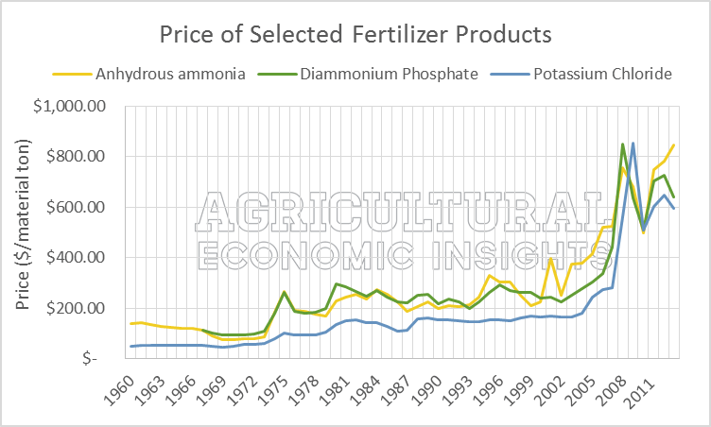
Long History Of Fertilizer Prices

Slide 24
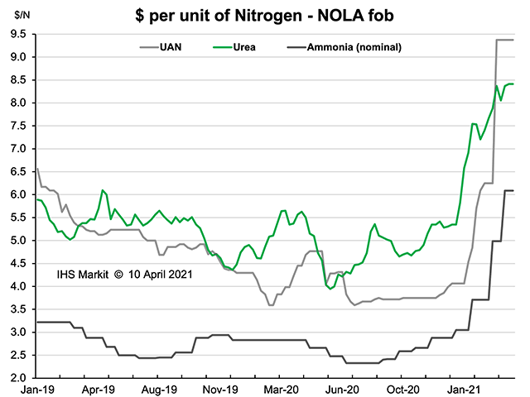
Recent History Of Fertilizer Prices

Slide 25
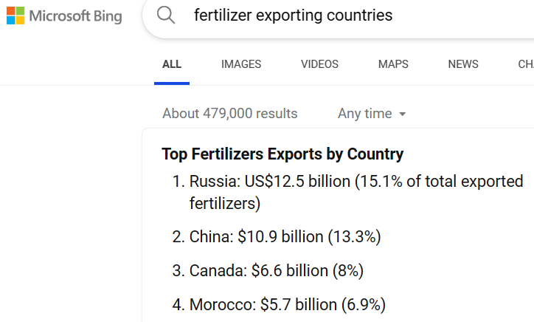
Have
we
learned
anything?
Source: www.worldstopexports.com/top-fertilizers-exports-by-country/

Slide 26
Below is a YouTube link to see a less than 3-minute animation of the Dungster Kit.
Beginning with the placement of the first “plain-vanilla” common dumpster.
It’s quick conversion into an in-vessel composter.
The aeration system’s easy installation and the layer-by-layer filling process.
The “bio-reactor” internal process is illustrated and the
conclusion is the extraction of the aeration pipes for re-use.
The role of the second/parallel dumpster is explained (the O.H.I.O. principle).
Watch it over-and-over again.
Share this with your equine friends.
https://youtu.be/H_wzYlHMta4

Slide 27
“Just do compost it”
Using my kit or another composting approach
dungstercomposting.com

Slide 28
“Manure Composting Benefits; Hygiene, Health & Ecology”
The Friday afternoon PowerPoint presentation will also be available soon.
This presented the many non-financial benefits of composting including:
Improves property aesthetics,
Reduction in non-point-source water pollution,
Reduction in green-house-gas production,
Disease and fly hatch mitigation and
Weed reduction in the resulting compost
Look for another email with this announcement coming soon!
dungstercomposting.com

Slide 29
“Bonus Presentation: Economy of Effort”
This PowerPoint presentation will also be available soon.
This reveals the power of the O.H.I.O. principle (Only Handle It Once) applied to manure management.
This saves valuable hours by avoiding unnecessary manure movements.
And, the obvious ecology benefit of manure never laying on open ground.
Finally, the financial benefit that the valued nurtriates in compost accrue to the owner’s benefit.
Look for another email with this presentation's announcement
dungstercomposting.com

Slide 30
Thank You!
dungstercomposting.com

